Slide 1
Wireless Naval Battle
Project review n°2

Slide 2
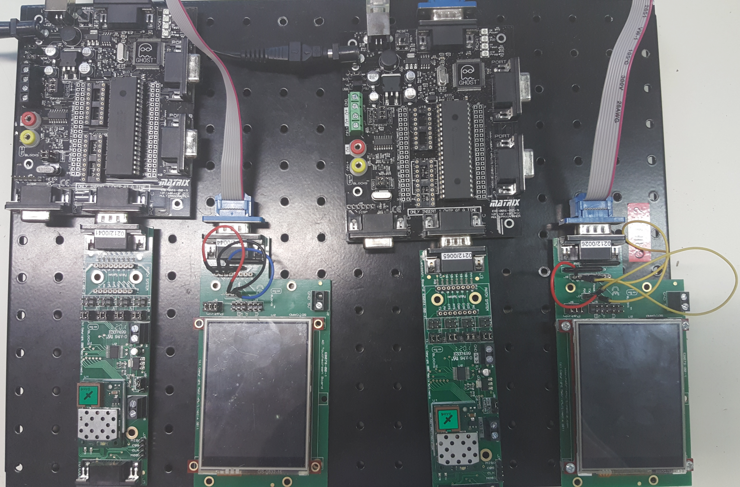
The Project
What has been done ?
Collective part
Personnal Part
What should have been done ?
Which problems did we encounter ?
Sustainable Developpement

Slide 3
What has been done ?
Placing the ships
Screen alternation
Case’s content verification
Alternating turns
Graphic improvement

Slide 4
What should have been done ?
Wireless Connections between systems

